Slide 1
Anomaly detection in video using spatiotemporal autoencoder
identify the areas of anomalies in a particular frame

Slide 2
Introduction
Identifying anomalous events in videos is vital for recognizing potential threats, accidents, or malfunctioning equipment
However, the complex nature of video data, which includes spatial and temporal dimensions, makes this task challenging

Slide 3
OVERVIEW
propose a method for detecting anomalies in videos using spatio-temporal autoencoders
The method involves converting videos into frames using FFmpeg, and then converting each frame into cuboids
Each cuboid is stored in a separate folder, and a spatio-temporal autoencoder is trained for each folder individually
The recreated cuboids are compared to the input cuboids, and the loss is calculated
If the loss is above a certain threshold, the cuboid is considered an anomaly.

Slide 4
Working
Our proposed method involves converting the video into frames using FFmpeg, a widely used multimedia framework. These frames are then transformed into cuboids which are three-dimensional pixel blocks. Each cuboid is saved in its own folder for subsequent processing. A spatio-temporal autoencoder is then trained on each folder of cuboids, learning the spatiotemporal features of the cuboids.

Slide 5
Our method starts with decomposing a video into individual frames using the FFmpeg tool. Each frame is divided into non-overlapping cuboids which are smaller three-dimensional sections containing spatial and temporal information.
These cuboids are stored in separate folders, and a spatio-temporal autoencoder is trained for each folder, utilizing the respective cuboids. This modular approach enables the autoencoder to learn the intricate patterns and relationships between the cuboids, providing a comprehensive representation of the video data.
These cuboids are then tested against their corresponding trained autoencoder models. The reconstruction loss, a measure of the discrepancy between the input and output cuboids, is calculated for each cuboid in the form of NumPy arrays.
If the loss exceeds a pre-defined threshold, the cuboid is considered anomalous

Slide 6
WHY THIS METHOD IS DIFFERENT
However, our proposed approach differs from these methods in several ways.
Firstly, we use cuboids for processing the frames, which helps in capturing the spatiotemporal features of the frames more accurately.
Secondly, we train a separate autoencoder model for each folder of cuboids, which aids in detecting anomalies more effectively.
Finally, we employ a threshold-based approach to detect anomalies, which assists in reducing false positives and improving detection accuracy

Slide 7
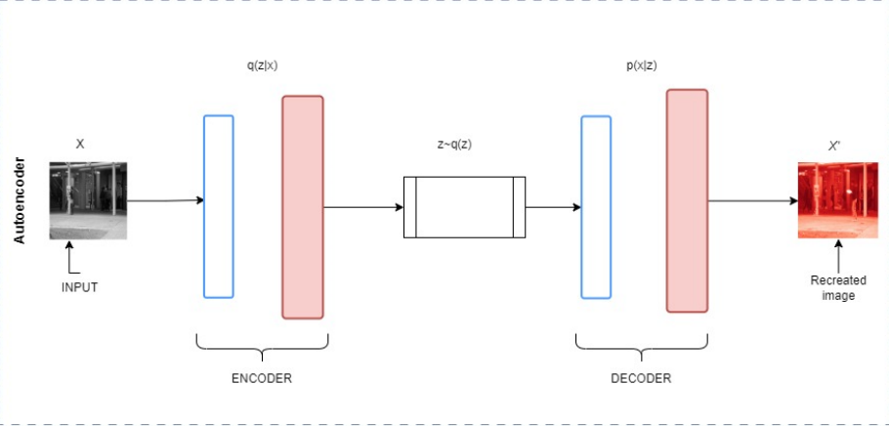
Proposed System
Autoencoder

Slide 8
STAGES
Video-to-Frame Conversion:-converting the input video into a sequence of frames. We utilize FFmpeg, a widely-used opensource multimedia framework, to perform this conversion efficiently.
Preprocessing of Frame:- steps to prepare the data for subsequent analysis. The preprocessing consists of two main steps: greyscaling and Gaussian blur.

Slide 9
Greyscaling
In greyscaling, we convert the color frames to grayscale images, which simplifies the data
By removing color information, we focus on the structural and textural patterns in the video, which are more relevant for anomaly detection.

Slide 10
Gaussian Blur
This step smooths the images and reduces noise, helping the spatio-temporal autoencoder to better focus on the significant patterns in the data
The Gaussian function is essentially a bell-shaped curve, which assigns higher weights to the pixels closer to the center and lower weights to the pixels further away

Slide 11
STAGES
Frame-to-Cuboid Conversion:-By breaking down the frame into these smaller units, the system can analyze each region separately, allowing for more accurate anomaly detection. The extracted cuboids are then processed by the trained spatio-temporal autoencoders, which attempt to reconstruct the input cuboids.

Slide 12
autoencoder and decoder
The autoencoder is composed of two primary components: the encoder and the decoder.
An autoencoder is a type of neural network that learns to encode and decode data in a lowerdimensional space.
Encoder: The encoder maps the input data, X, into a lower-dimensional latent space, Z.
The encoder aims to compress the input data into a more compact representation while preserving as much information as possible.
Decoder: The decoder takes the latent representation, Z, and reconstructs the original input data, X’
The success of the autoencoder model is often evaluated by comparing the input image X and the reconstructed output image X’.
The autoencoder is trained for 100 epochs with a batch size of 32

Slide 13
TRAINING
During training, the spatiotemporal autoencoder learns to reconstruct the input cuboids by encoding them into a lower-dimensional representation and then decoding them back to their original form

Slide 14
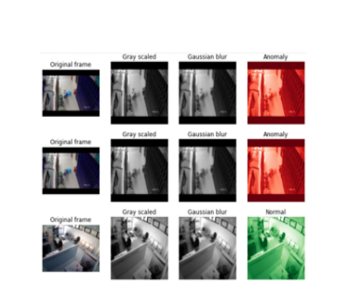
Anomaly Detection
By comparing the input cuboids with their reconstructed counterparts, we can compute a loss value representing the difference between the two.

Slide 15
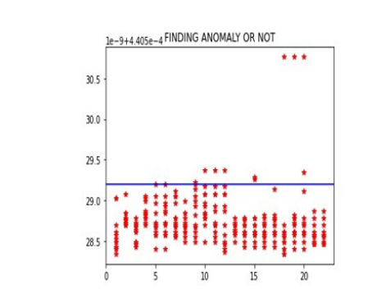
The graph depicts a blue line that represents the threshold, and all points plotted above this line are classified as anomalies, while points below the line are considered normal.

Slide 16
Evaluation Metrics:
Precision is calculated as the number of true positive cuboids over the number of true positive cuboids plus the number of false positive cuboids.
. Recall is calculated as the number of true positive cuboids over the number of true positive cuboids plus the number of false negative cuboids

